Slide 1

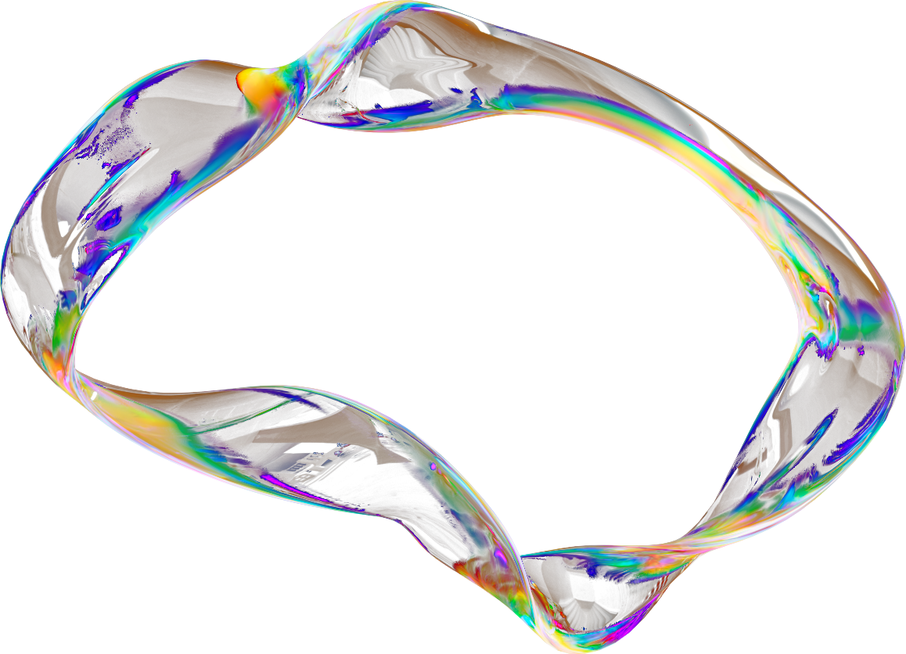
DJ ART DESIGNER
Present Djavan BORIUS
and Andrea CRISAFULLI

Slide 2
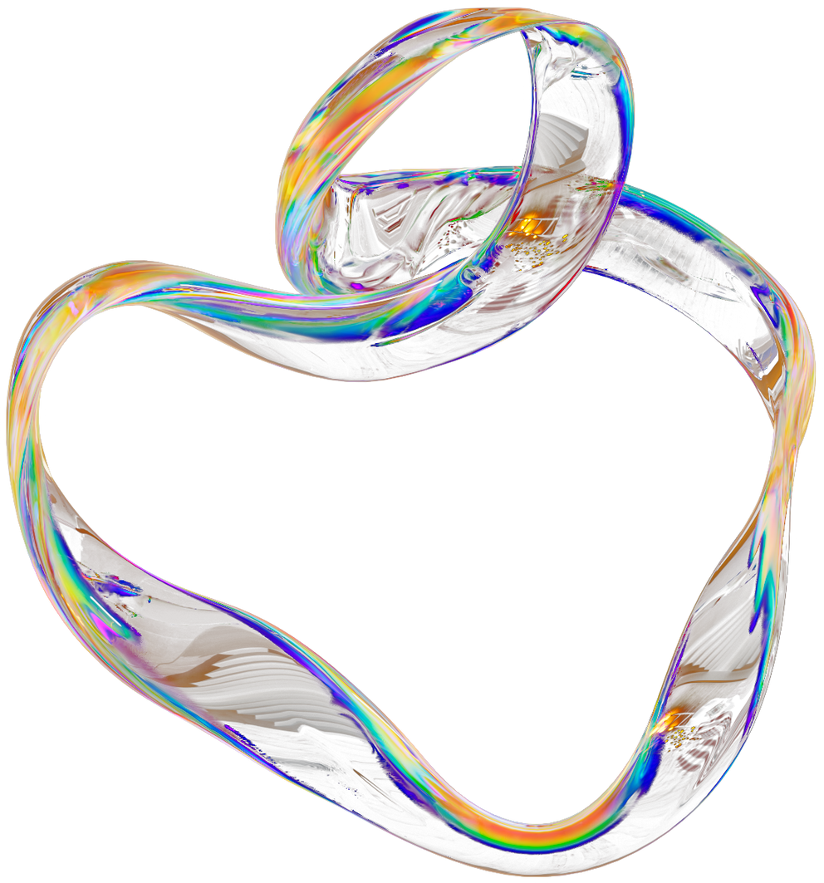

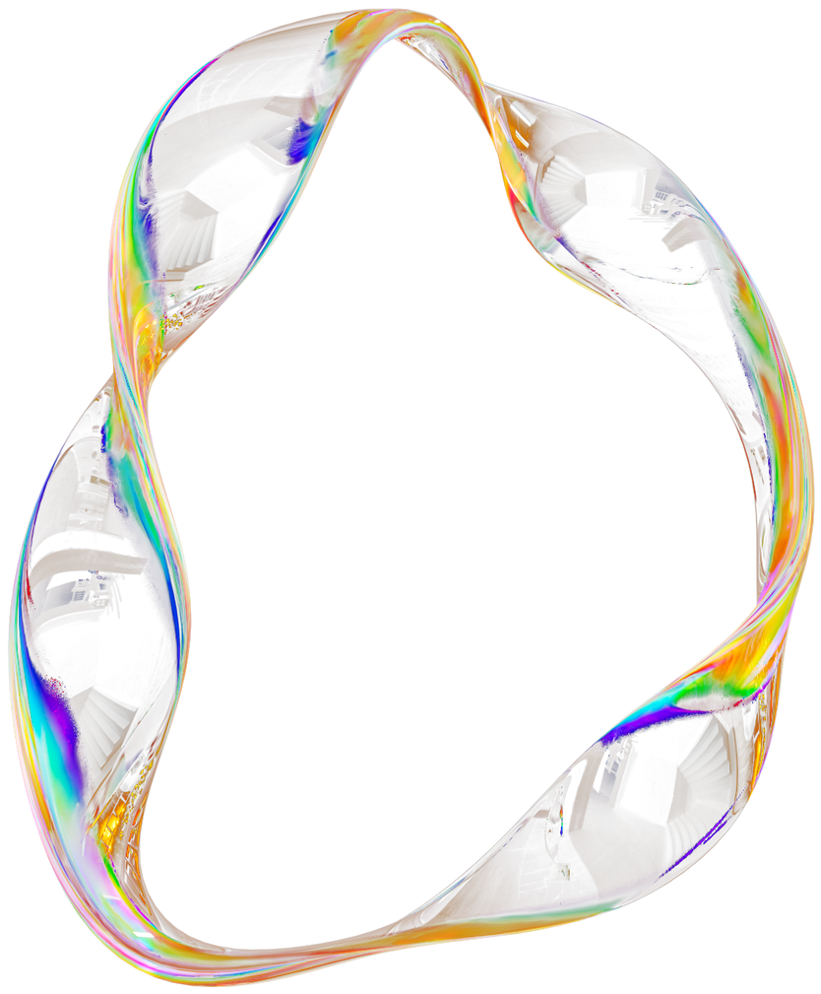
CONTENTS
1
Project Description
6
Module 3 : Fractal Art
2
Our Innovative Solutions
7
Module 4 : Interactive Painting
3
Module 1 : Chladni Patterns
8
Conclusion
4
Features
5
Module 2 : Circle Dancing

Slide 3
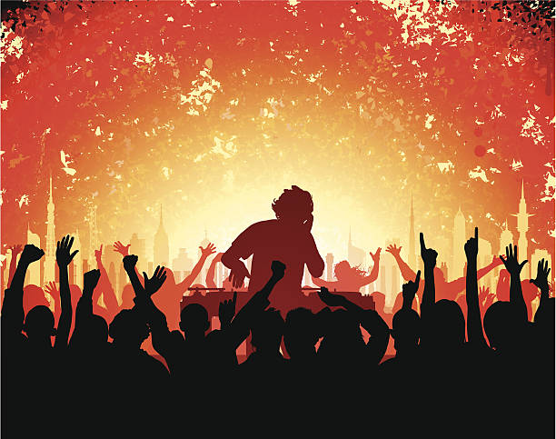
PROJECT DESCRIPTION
The Concept:
Mix Between NID and Generative Art
Automatic visuals generator
The Purpose:
Enhancement of the DJ performance
To give the audience a visual feedback associated to music involving them more
To create interaction between crowd and performance
The User Experience:
Easy to use
Use of OSC apps
All modules are coded in Processing except for fractal module that is coded with TouchDesigner

Slide 4
TECHNICAL SOLUTIONS
Reactive Agent (Reflex agent)
Environment : OSC message and sound coming from rekordbox is fully observable
Real time agent => choose between performance and computational time
Sensors :
Virtual line audio cable not optimal because of the richness of the data collected
Interaction with crowd modeled with phones and sensor2OSC
Many Softwares to model the interactions (Processing, Rekordbox, TouchDesigner, OSC controller...)

Slide 5
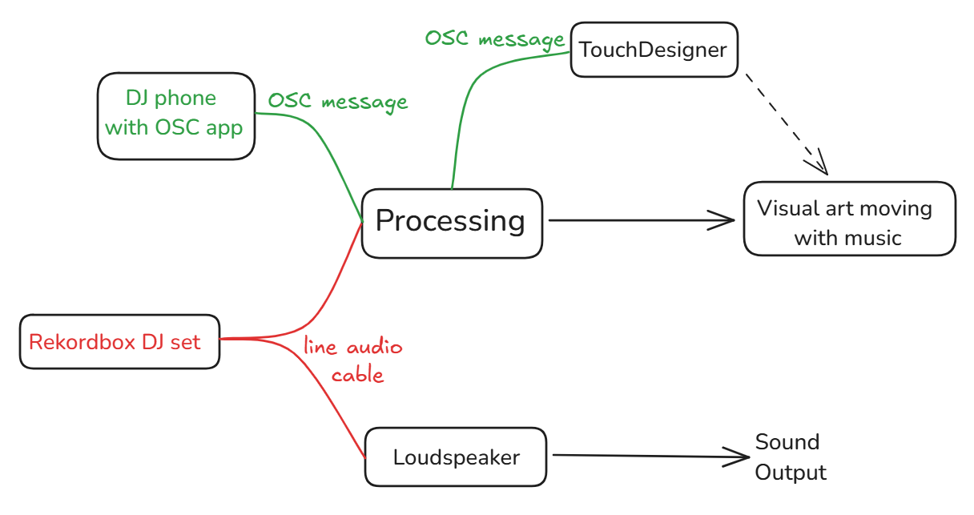

Slide 6
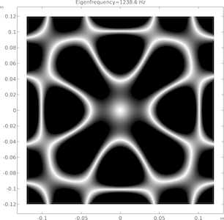
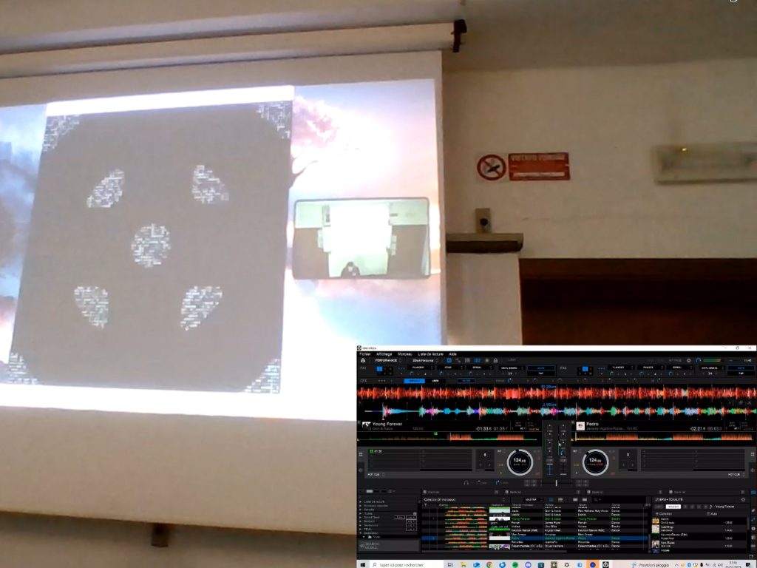
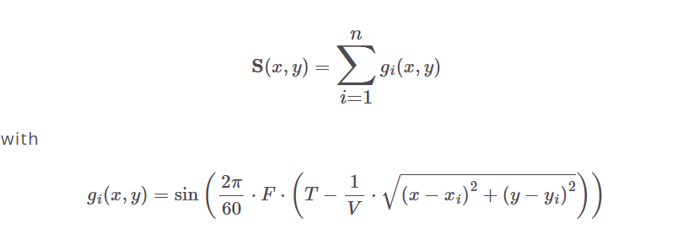
MODULE 1 : CHLADNI PATTERNS
Idea : Table of grains positioned on a grid discretized as 100x100
Calculate the mode according the following formula

Slide 7
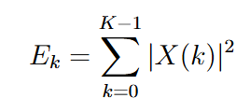
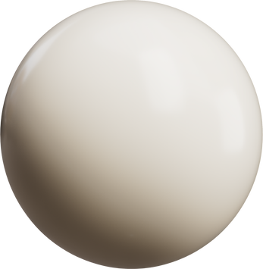
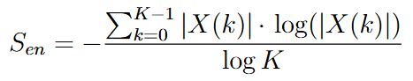
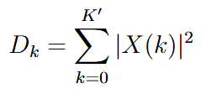
FEATURES FRAME TO FRAME
This function extracts low level features of
the music played by the DJ in real time.
These features are used as parameters to modify visuals.
Energy
Entropy
Drop (energy focused on the low frequencies k’)

Slide 8
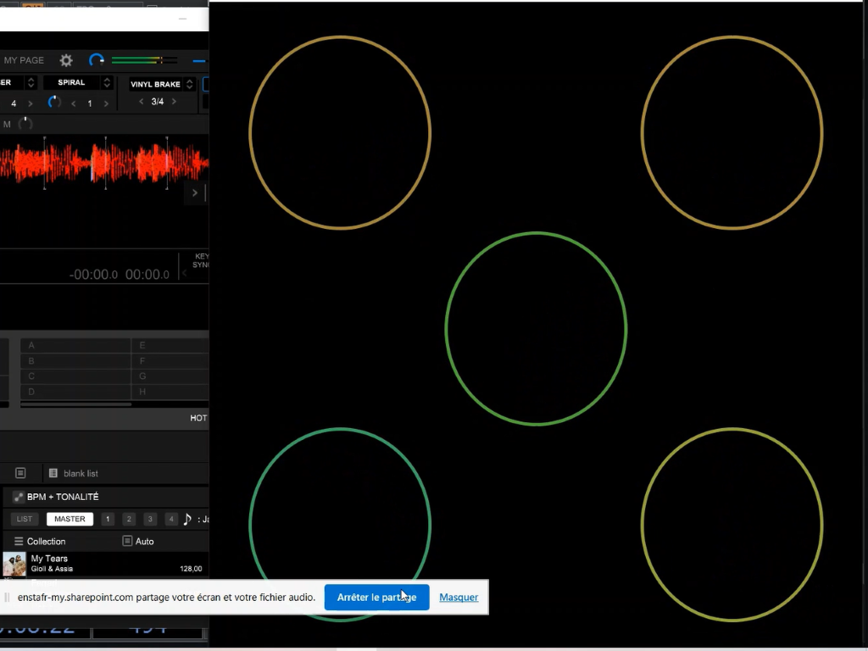
MODULE 2 : CIRCLE DANCING
This module displays circles that reacts according to the features of the music played:
Energy: controls the color and the thickness of circles;
Entropy: controls the width and the height of circles;
Drop: once passed a setted threshold 5 circles are showed instead of 1 allowing to feel more intensively the energy of drops made by DJ

Slide 9
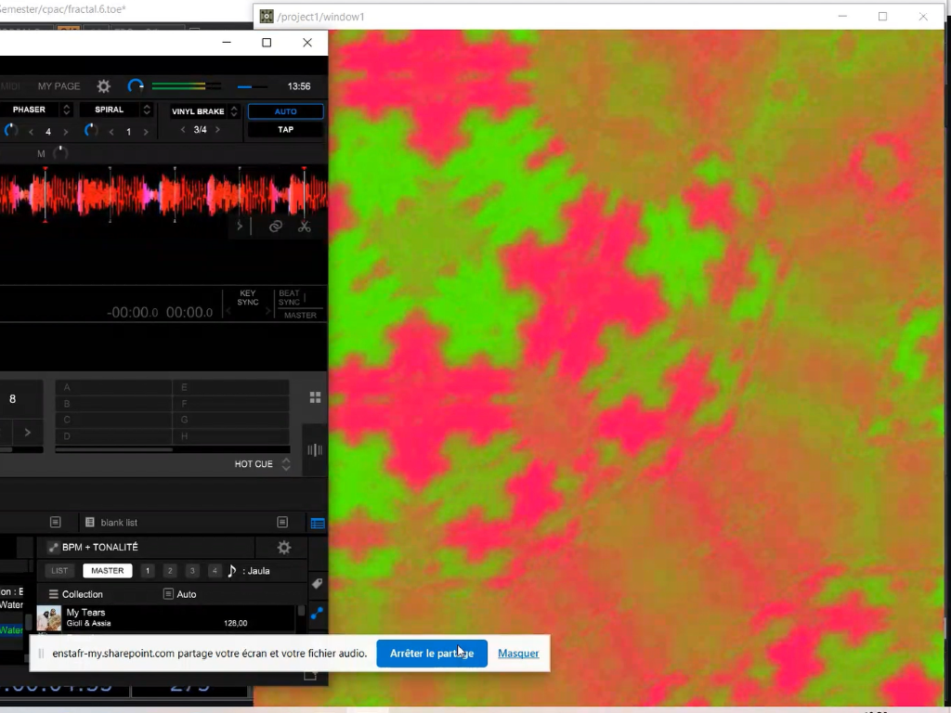
MODULE 3 : FRACTAL ART
Using Features values we calculated :
Energy
Drop
Entropy
Send with OSC message to TouchDesigner
Using different modules in TouchDesigner (CHOPs, TOPs, COMP etc) we can succed and arrive to a virtual art reacting to the music played

Slide 10
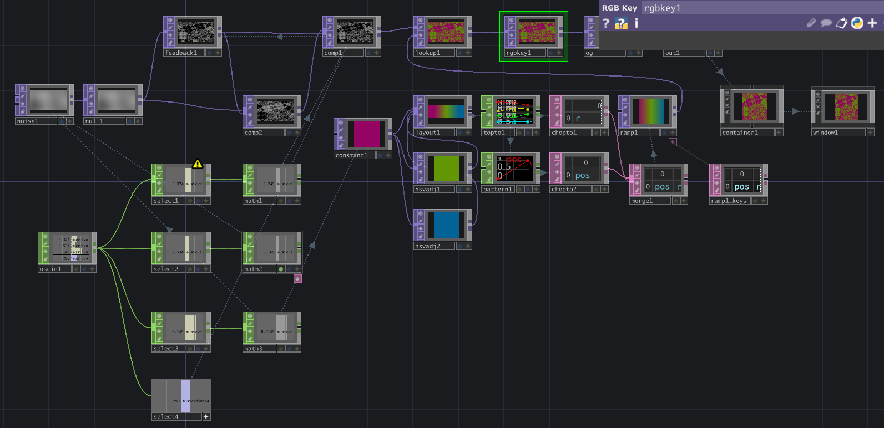
TOUCHDESIGNER
CHOP noise
and loop
TOP for color
CHOP to collect and interpret OSC message

Slide 11
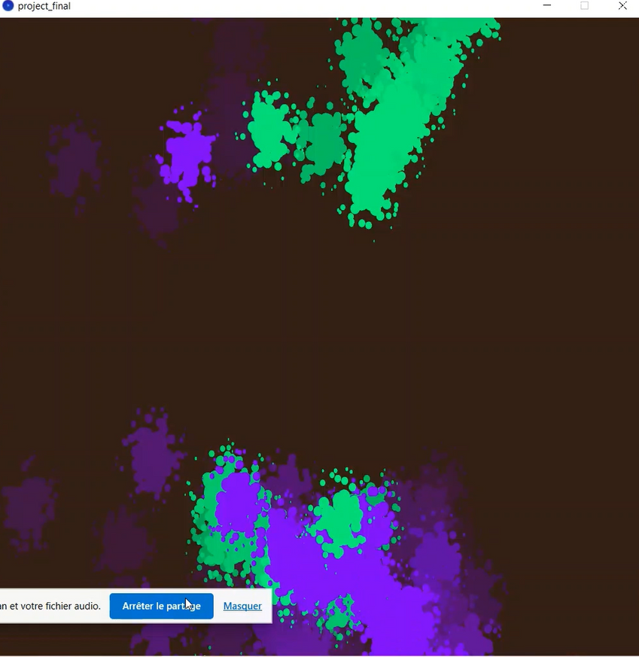
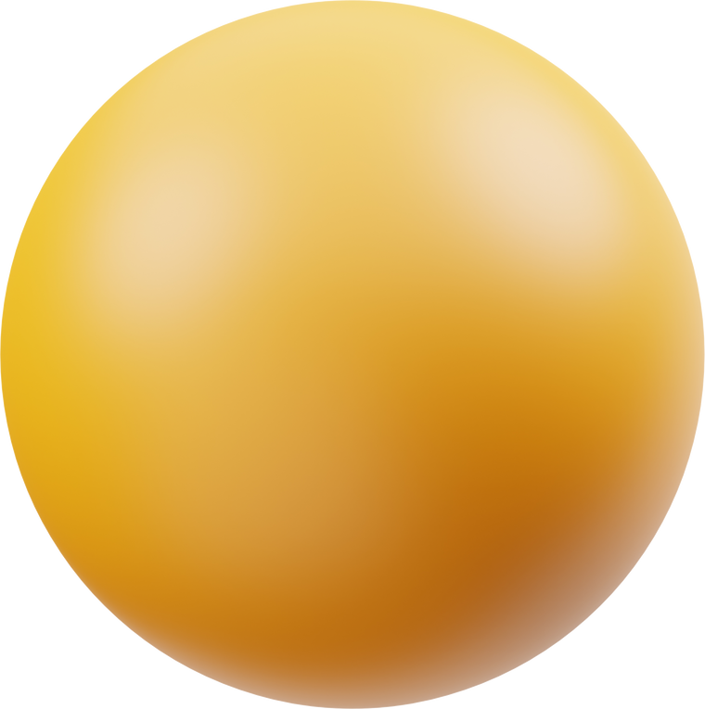
MODULE 4 : INTERACTIVE PAINTING
1ST : CONNECT DEVICE SENDING GYROSCOPE VALUES TO COMPUTER
2ND : INTERPRET THE MESSAGES
AND ASSOCIATE COLOR TO DIFFERENT IP ADRESS
3RD : DANCE AS MUCH AS YOU CAN !
Sensor used during demo : sensor2OSC on android with 2 phones
Advised sensors : connected bracelets with gyroscope and connected with ARTNet or OSC messgages

Slide 12
MOTIVATIONS & CONCLUSION
As we are both musicians we experinced playing in front of a crowd and what it makes unique is the interaction with people .
So we thought of a way to increase the involvement and to give them a visuals associated with music and to make them collaborate in creating visuals is the best solution for us, since we think people are more involved if they have a visual feedback.
We think that with the different modules of the ART DJ Designer we accomplish this purpose. Furthermore we let space for more modules to be created and we can improve or vary the existing ones (with subscription to TouchDesigner, OSC app or having more interacting device).

Slide 13
THANK YOU
Be ready for the demo !

